Slide 1
Prematurity
Reproductive Health Module
Faculty of Medicine Ragama
June 2016

Slide 2
Introduction
Worldwide 15 million babies are born preterm
Preterm birth complications are the leading cause of death among children under 5 years of age
¾ could be saved with current, cost-effective interventions.
Rate of preterm birth: 5% to 18% (SL about 15%)

Slide 3
Definitions
Gestational age
<37 weeks completed
Extremely preterm
  <28 weeks gestation
Very preterm
  28+0 weeks to 31+6 weeks gestation
Moderate to late preterm
  32+0 weeks a to 36+6 weeks gestation

Slide 4
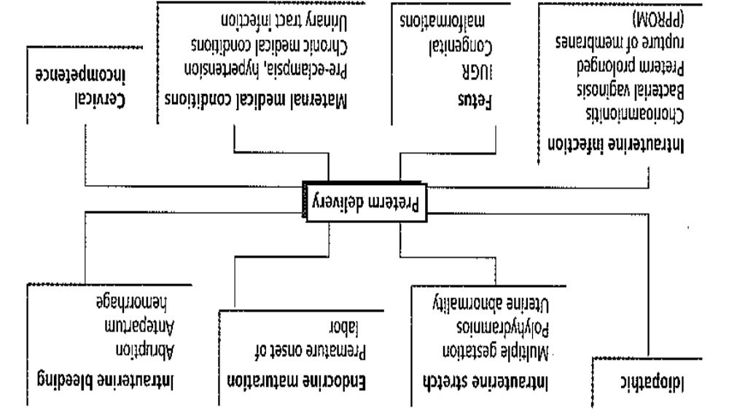
Causes of preterm delivery

Slide 5
Prevention of preterm birth and its complications
Prolong pregnancy as long as is safely possible
  Tocolytics, cervical circlage, progesterone
Antenatal steroids
Magnesium sulphate
Delivery of high risk infants in tertiary centre

Slide 6
Immediate Complications of prematurity
Hypothermia
Hypoglycaemia
Respiratory distress syndrome
Infections
Necrotising enterocolitis (NEC)
Feed intolerance
Apnoea of prematurity
Intraventricular haemorrhages

Slide 7
Intermediate complications
Jaundice of prematurity
Osteopaenia of prematurity
Retinopathy of prematurity
Anemia of prematurity

Slide 8
Long term complications
Cerebral palsy
Other neurological complications depending on problems encountered during neonatal period

Slide 9
Hypothermia
Reduced Surface Area /volume ratio
Reduced Subcutaneous fat
Reduced Brown fat ( esp SGA )
Reduced energy stores
Exposure
Wet

Slide 10
Heat loss
Conduction ( contact c. cold surface)
Convection ( air currents )
Radiation ( radiating to cooler surface )
Evaporation ( baby wet, also transepidermal)

Slide 11
Heat Loss : Management
Pre-warm radiant heater
Minimise exposure time-don’t mess around
Dry
Use plastic wrap/oven bag
Change drapes to dry drapes
Assess need for incubator care
Use transport incubator
Maintain neutral thermal range
Use incubator; open only when necessary
Minimum handling
If ELBW : use humidification in incubator

Slide 12
Bacterial infection
Predisposed by
  antenatal exposure
  Prematurity
  Immature skin
  Devices ( IV etc )
  Immature immune system
Polypharmacy /unnecessary broad spectrum antibiotics- resistant organisms

Slide 13
Respiratory Distress
Surfactant deficient lung disease
– most common in < 32 weeks
- hyaline membrane disease
Other causes
TTN “wet lung”
Pneumonia
Congenital malformation ( eg CDH, OA )
Pneumothorax

Slide 14
Respiratory Distress
Tachypnoea
Intercostal recession
Sternal recession
Paradoxical respiratory movement
GRUNT
Oxygen requirement

Slide 15
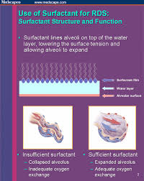
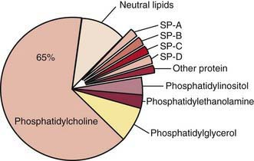
Respiratory Distress Syndrome
Surfactant deficiency
Increases alveolar surface tension
Collapses lung alveoli

Slide 16
Resp Distress: Management
A.B.C.
Minimal handling
Minimal FiO₂ to achieve 90-94% saturation (Avoid nasal prong oxygen for preterm babies – unless for chronic lung disease)
Assess for infection – treat if indicated
IV fluids:
Consider need for invasive monitoring
Decide need for particular ventilatory support

Slide 17
Resp. Distress : Management
CPAP – from time of birth
“Delivery room CPAP”
- avoid need for invasive ventilation
Ventilation - conventional - HFOV
Surfactant - as ‘rescue’ rather than ‘prophylactic’
NICU
( Inotropes )

Slide 18
Intraventricular Haemorrhage
Gestation related. Rare > 32/40
Most major IVH < 28/40
Bleeding from germinal matrix
Blood into ventricles
Venous obstruction may cause periventricular infarction
Seizure
Hydrocephalus
Cerebral palsy/ learning disability
Minor grades : risk of poor nerudevelopment low

Slide 19
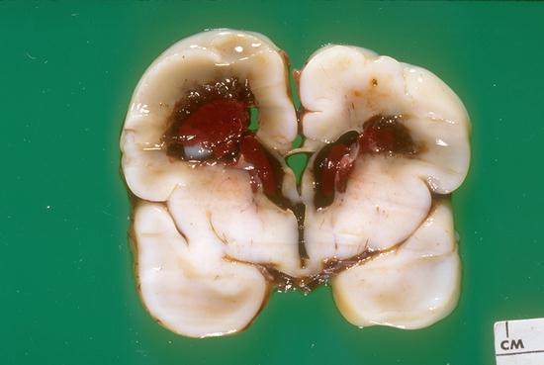

Slide 20
Feeding
Expressed breastmilk preferred
NEC incidence
EBM: EBM + Formula : Formula 1:3:6
Gut dysmotility
Necrotising enterocolitis
Inflammation of gut resulting in gut ischaemia and bacterial migration

Slide 21
Anemia of prematurity
Due to bone marrow non responsiveness
Iatrogenic
Later if hematinics not started at correct age
Blood transfusion not indicated if retic count is high

Slide 22
Approach to small baby
Talk to parents antenatally. Give idea of what to expect. Find out any issues - liaison with Obstetric team
Preparation of resuscitation equipment
ABC
Minimal handling
Neutral thermal environment
Asses respiratory support needs: ? Vent ? CPAP ? Oxygen
Consider and cover infection
Nursery/incubator care preparation

Slide 23
Iatrogenic Complications of Prematurity
Pneumothorax
Bronchopulmonary Dysplasia
Subglottic stenosis
Retinopathy of prematurity
Feed intolerance/orally aversive behaviour
Nosocomial infection with resistant organisms
“IV burns”
Separation/Psychosocial

Slide 24
Parents
Shocked, chaotic, overwhelmed
Unwell, tired, in pain
Scared, disempowered
Noise
No privacy, crowding, other families, new social rules
Need to keep rest of life, family etc together

Slide 25
Parents
Need frank discussion of outcome and choices
Inevitably need repeated discussions
Look for self – blame, anger. Deal with it.
Need good orientation to nursery
Stable contact with 1-2 senior people

Slide 26
Outcome
< 22 weeks : minimal survival
23 weeks : 30%
24 weeks : 60%
28 weeks : 90%
30 weeks : 95%
Disability overall < 1000g
Severe ~8%
Moderate ~15%

Slide 27


Slide 28


